Slide 1

Vel Tech Rangarajan Dr. Sagunthala R&D Institute of Science and Technology
School of Computing
Department of Computer Science and Engineering
10211CS224 / FULL STACK APPLICATION DEVELOPMENT (JAVA)
PROJECT REVIEW : MILESTONE PROJECT – 1
Date: 26-03-2026
Dynamic Online Examination & Result Processing System
SDG: SDG No – SDG 4- Quality Education
Presented By:
DASARI VASU – VTU24686 – Reg.No:23UECS0144
Courses Handling Faculty:
Dr. Hafizur Rahman- B.E., M.Tech., Ph.D.

Slide 2
INTRODUCTION
1
Online examinations are becoming an important part of modern education systems.
Traditional paper-based exams require more time, manual effort, and resources.
Managing exams, evaluating answers, and publishing results manually can lead to delays and errors.
The Dynamic Online Examination & Result Processing System provides a digital solution for conducting exams online.
This system allows students to register, login, and take exams through a web application.
The system automatically evaluates answers and generates results instantly.
It helps institutions manage exams efficiently with less manual work.
This project demonstrates how web technologies can simplify and automate examination processes.
2
3
4
5
6
7
8
9

Slide 3
PROBLEM STATEMENT
1
Traditional examination systems depend mainly on paper-based tests and manual evaluation.
Managing exam papers, checking answers, and calculating results requires significant time and effort.
Manual result processing may lead to human errors and delays in publishing results.
It is difficult for institutions to conduct frequent assessments efficiently using traditional methods.
Students also have limited flexibility in accessing exams and results quickly.
There is a need for a system that can automate the examination and evaluation process.
A web-based solution can simplify exam management and improve accuracy.
Therefore, the Dynamic Online Examination & Result Processing System is developed to address these issues.
2
3
4
5
6
7
8
9

Slide 4
OBJECTIVE(S)
1
To design and develop a Dynamic Online Examination & Result Processing System for conducting exams online.
To provide a secure registration and login system for students to access the examination platform.
To implement an online examination interface where students can attempt multiple-choice questions.
To automate the evaluation process and generate results instantly after exam completion.
To store exam records and result history in a database for future reference and analysis.
2
3
4
5
6
7
8
9

Slide 5
PROPOSED SYSTEM
1
The proposed system is a web-based Dynamic Online Examination & Result Processing System.
It allows students to register, login, and access available exams online.
Students can select a subject and attempt multiple-choice questions within a given time limit.
The system automatically evaluates answers and calculates the score instantly.
Exam results are stored in a database for future reference and analysis.
Students can view their exam history and performance reports anytime.
The system reduces manual work, human errors, and result processing time.
It provides a fast, reliable, and efficient solution for managing online examinations.
2
3
4
5
6
7
8
9

Slide 6
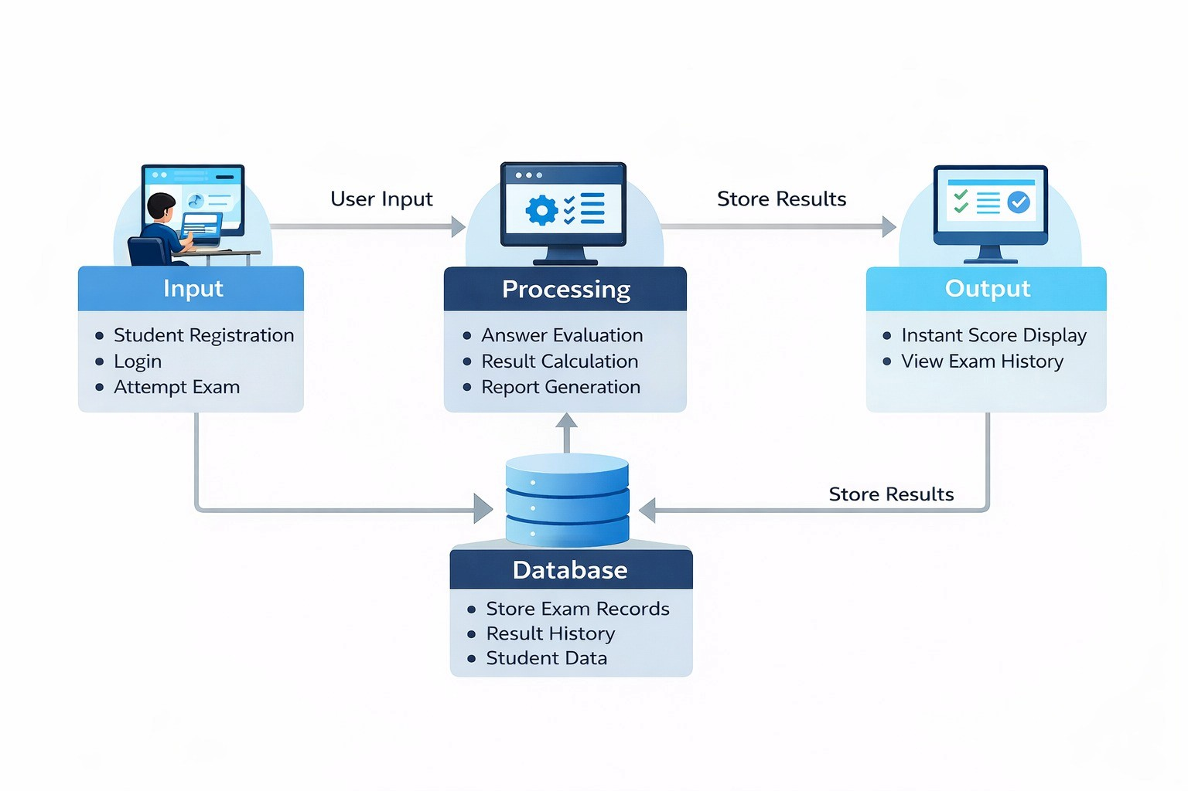
PROPOSED SYSTEM ARCHITECTURE
1
2
3
4
5
6
7
8
9

Slide 7
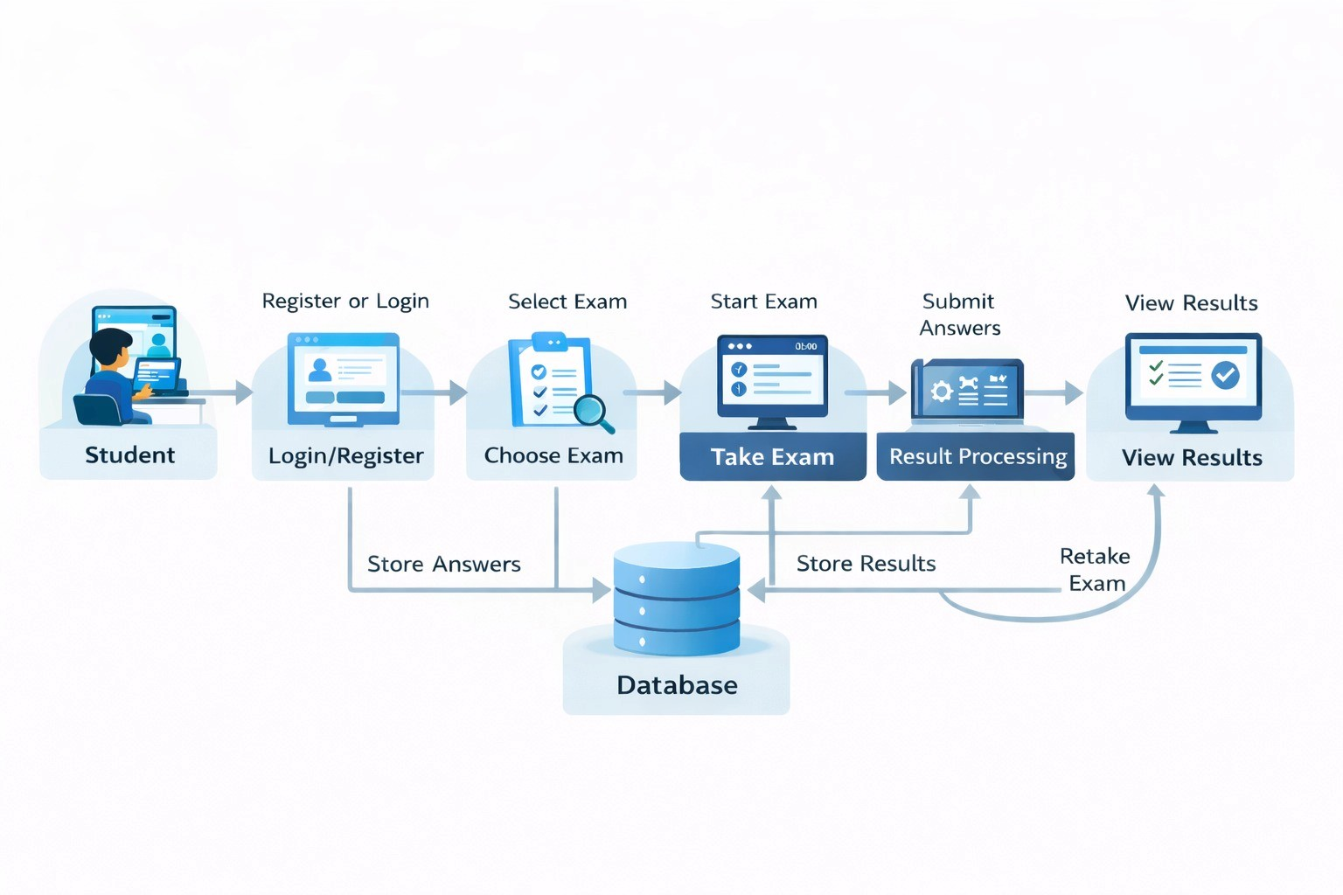
WORKFLOW
1
2
3
4
5
6
7
8
9

Slide 8
TECHNOLOGIES USED
Frontend:
HTML5
CSS3
Backend:
PHP (Core PHP)
Session Management
MySQL(Database Connectivity)
Database:
MySQL
phpMyAdmin
Tools:
XAMPP (Apache + MySQL Server)
Notepad
Web Browser (Chrome)
Hardware / Software Requirements:
System: Windows 10
RAM: Minimum 4GB
Software: XAMPP Server
1
2
3
4
5
6
7
8
9

Slide 9
MODULE DESCRIPTION
1
Module 1: User Authentication Module
Handles student registration and login.
Ensures secure access to the examination system.
Module 2: Exam Management Module
Displays available exams for students.
Allows students to select and start the exam.
Module 3: Examination Processing Module
Shows questions and records student answers.
Manages the exam timer and question navigation.
Module 4: Result Processing Module
Automatically evaluates answers.
Generates the final score and percentage.
Module 5: Result History Module
Stores previous exam attempts.
Allows students to view their exam history and performance.
2
3
4
5
6
7
8
9

Slide 10
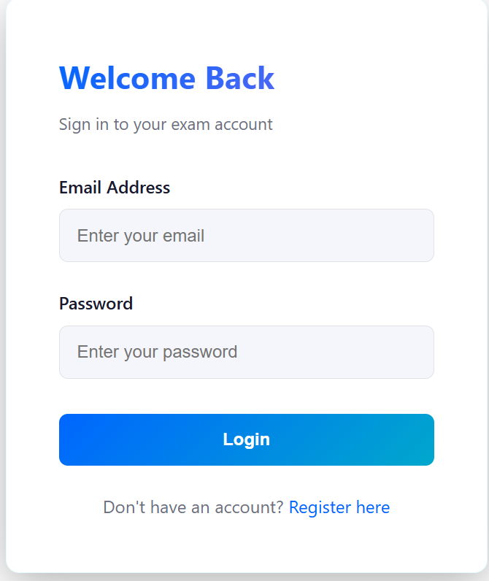
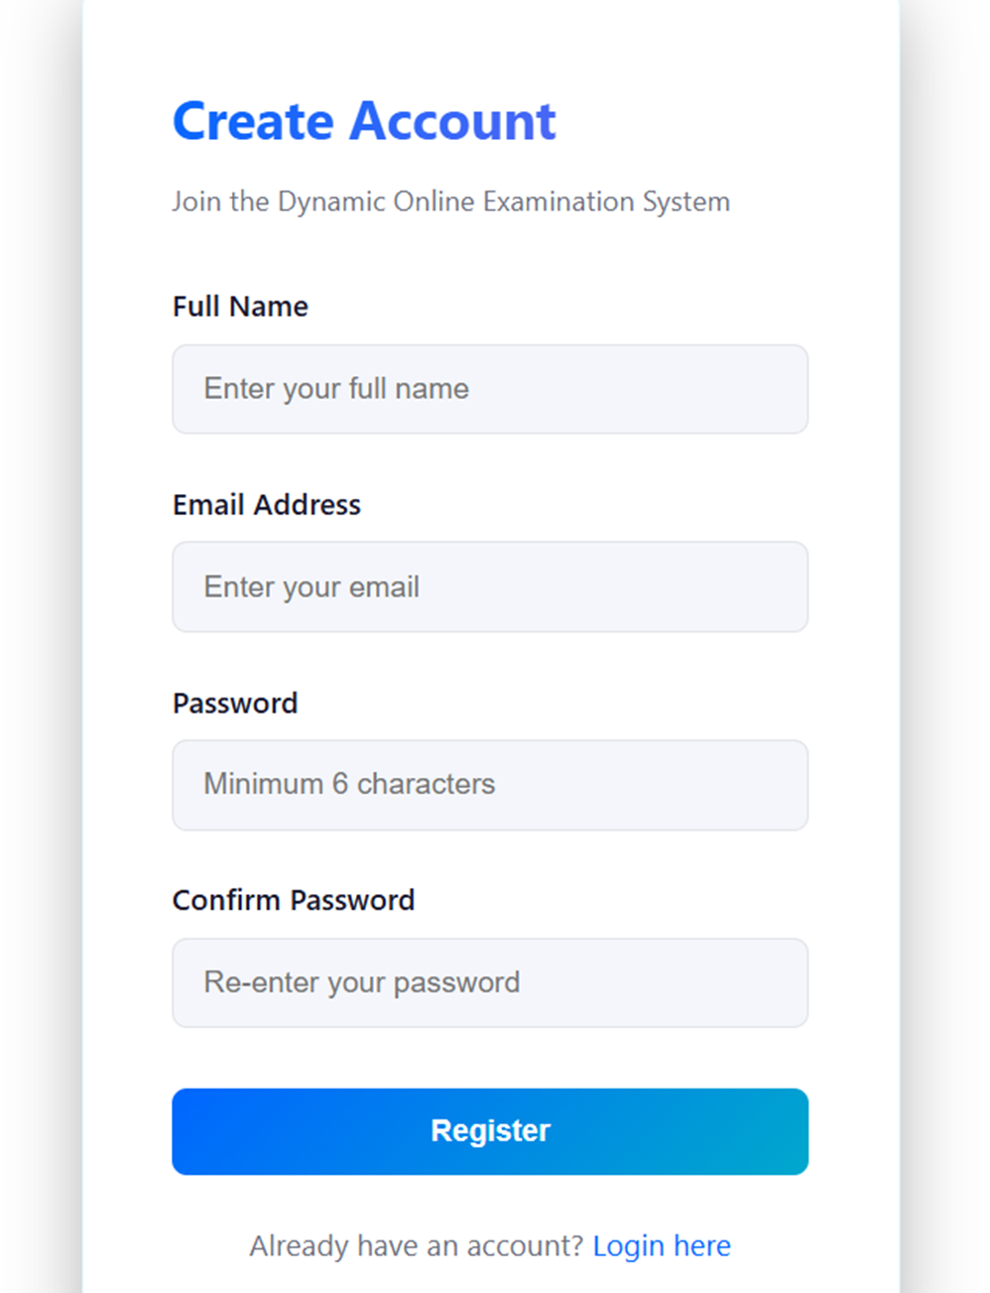
IMPLEMENTATION SCREENSHOTS
1
Login Page :
Allows registered students to enter their email and password to access the system.
The system verifies the credentials from the database for authentication.
After successful login, the user is redirected to the exam dashboard to select exams.
2
3
4
5
6
7
8
Register Page :
Enables new users to create an account by entering name, email, and password.
The system stores the user details securely in the database
After successful registration, the user can login and access the online examination system.
9

Slide 11
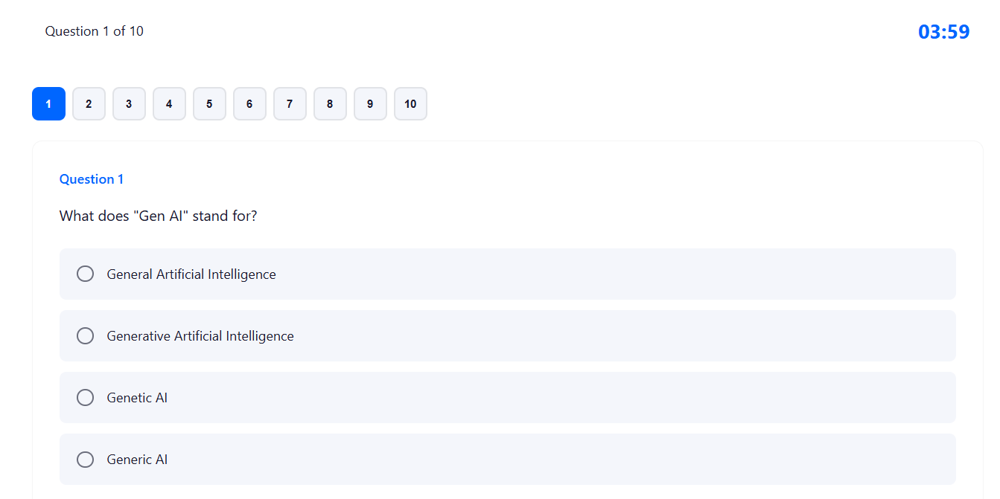
IMPLEMENTATION SCREENSHOTS
Exam Page :
Displays multiple-choice questions with answer options for the selected exam.
Includes a timer and question navigation to manage the exam within the given time.
Records the student’s selected answers and allows moving to the next question.
1
2
3
4
5
6
7
8(A)
9

Slide 12
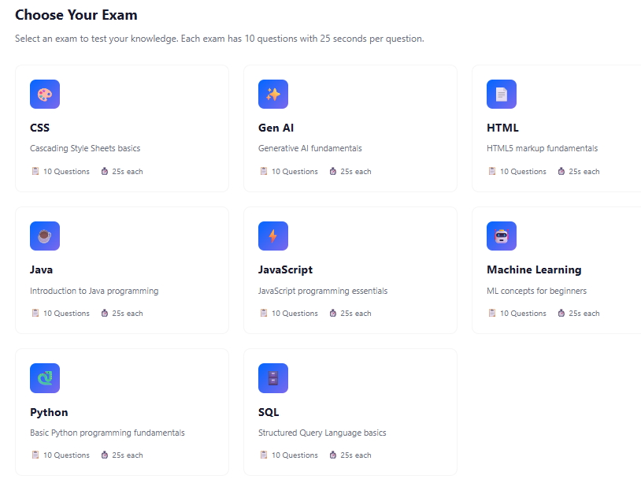
IMPLEMENTATION SCREENSHOTS
Exam Selection Page :
Displays a list of available exams such as HTML, CSS, JavaScript, Java, Gen AI, and Machine Learning.
Each exam card shows number of questions and time allocated for the exam.
Students can select any exam to start the test and evaluate their knowledge.
1
2
3
4
5
6
7
8(B)
9

Slide 13
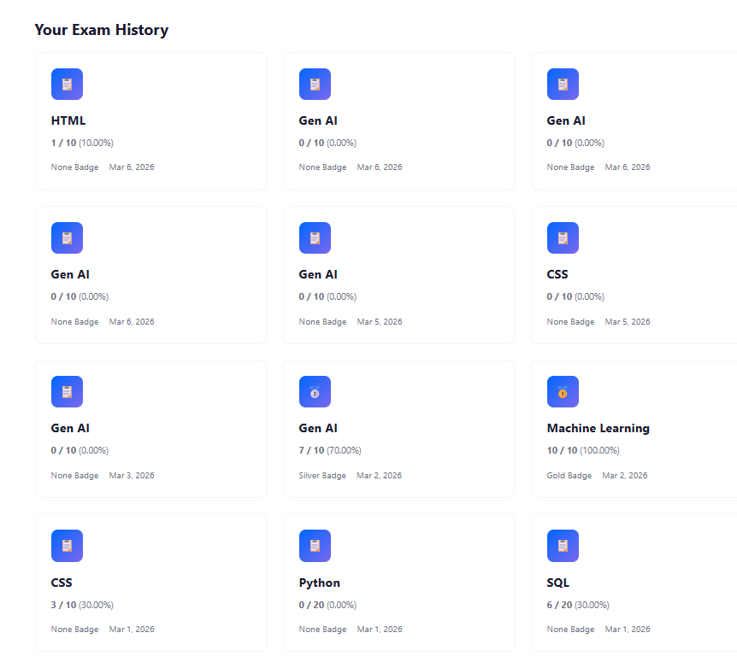
IMPLEMENTATION SCREENSHOTS
1
Exam Results / History Page :
Displays the student’s previous exam attempts and results.
Shows details such as exam name, score, percentage, badge, and date.
Helps students track their performance and review their exam history.
2
3
4
5
6
7
8(C)
9

Slide 14
ADVANTAGES & LIMITATIONS
1
Advantages:
Conducts examinations online, reducing paper usage and manual work.
Automatic result generation saves time and improves accuracy.
Students can access exams and results easily through the web application.
Stores exam history and performance records for future reference.
Provides a fast and efficient examination process.
Limitations:
Requires stable internet connectivity to take the exam.
Limited to objective-type questions in the current implementation.
System security needs improvement to prevent malpractice or cheating.
Requires server and database maintenance for smooth operation.
2
3
4
5
6
7
8
9

Slide 15
Thank you

